Slide 1
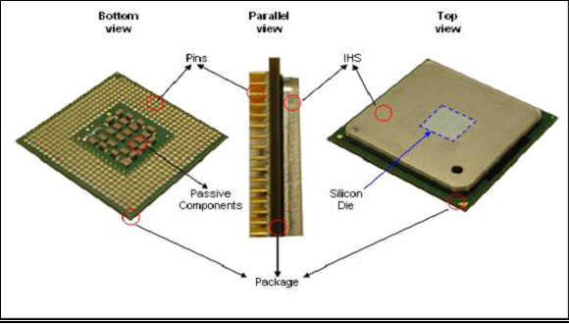
Central Processing Unit
Processor
It is a brain of a computer
It performs all actions according to set of instruction

Slide 2
Processor
Central Processing Unit Architecture operates the capacity to work from “Instruction Set Architecture” to where it was designed.
There are two architectural designs of CPU they are
-RISC (Reduced instruction set computing) and
-CISC (Complex instruction set computing)

Slide 3
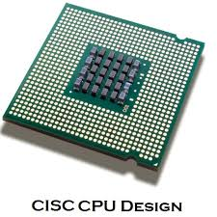
CISC
CISC has the ability to execute addressing modes or multi-step operations within one instruction set.
It is the design of the CPU where one instruction performs many low-level operations.
For example, memory storage, an arithmetic operation and loading from memory.

Slide 4
Characteristics of CISC
Instruction-decoding logic will be Complex.
One instruction is required to support multiple addressing modes.
Less chip space is enough for general purpose registers for the instructions that are operated directly on memory.
Various CISC designs are set up two special registers for the stack pointer, handling interrupts, etc.
MUL is referred to as a “complex instruction” and requires the programmer for storing functions.

Slide 5
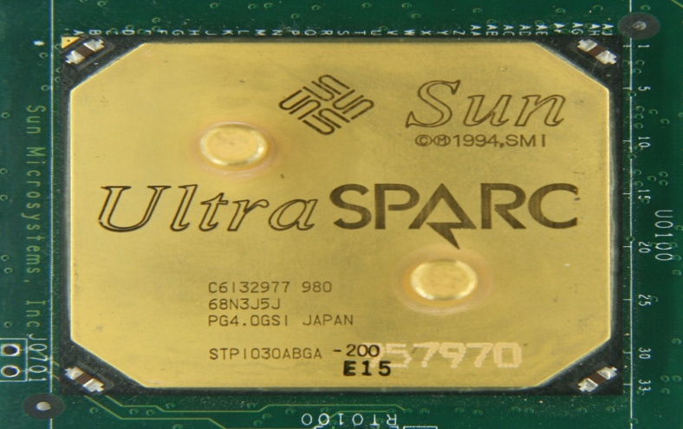
RISC
RISC was designed with a strategy that simple instruction set gives higher performance when combined with a microprocessor architecture.
It has the ability to execute the instructions by using some microprocessor cycles per instruction.

Slide 6
Characteristics of RISC
Simple Instructions are used in RISC architecture.
RISC helps and supports few simple data types and synthesize complex data types.
RISC utilizes simple addressing modes and fixed length instructions for pipelining.
RISC permits any register to use in any context.
One Cycle Execution Time
The amount of work that a computer can perform is reduced by separating “LOAD” and “STORE” instructions.

Slide 7
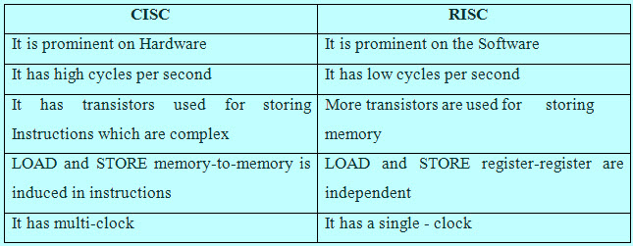
Difference between RISC and CISC

Slide 8
Multitasking :
Multitasking, in an operating system, is allowing a user to perform more than one computer task.(such as the operation of an application program) at a time.
The operating system is able to keep track of where you are in these tasks and go from one to the other without losing information.

Slide 9
Multiprogramming :
Multiprogramming is a rudimentary form of parallel processing in which several programs are run at the same time on a uniprocessor.
Since there is only one processor there can be no true simultaneous execution of different programs.
Instead, the operating system executes part of one program, then part of another, and so on. To the user it appears that all programs are executing at the same time.

Slide 10
MultiThreading :
Multithreading is the ability of a program or an operating System Process to manage its use by more than one user at a time and to even manage multiple requests by the same user without having to have multiple copies of the programming running in the computer.
Each user request for a program or system service (and here a user can also be another program) is kept track of as a Thread with a separate identity. As programs work on behalf of the initial request for that thread and are interrupted by other requests, the status of work on behalf of that thread is kept track of until the work is completed.

Slide 11
Hyper-Threading
Hyper-threading is a technology developed by Intel Corporation. It is used in certain Pentium 4 processors and all Intel Xeon processors. Hyper-threading technology, commonly referred to as "HT Technology," enables the processor to execute two threads, or sets of instructions, at the same time.
Since hyper-threading allows two streams to be executed in parallel, it is almost like having two separate processors working together.

Slide 12
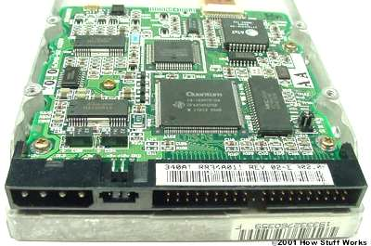
Integrated Device Electronics (IDE)
Floppy drive ,Hard drive ,CD-ROM drive Usually, these devices connect to the computer through an Integrated Drive Electronics (IDE) interface.

Slide 13
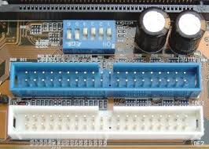
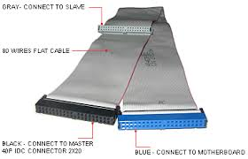
Integrated Device Electronics (IDE)
IDE Connector
IDE Cables

Slide 14
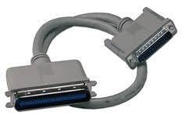
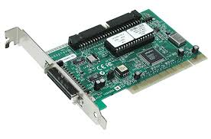
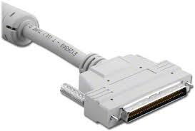
Small Computer System Interface (SCSI)
It's a fast bus that can connect lots of devices to a computer at the same time, including hard drives, scanners, CD-ROM/RW drives, printers and tape drives
SCSI Controller
SCSI Cables

Slide 15
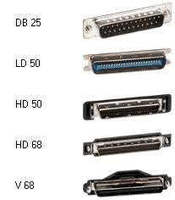
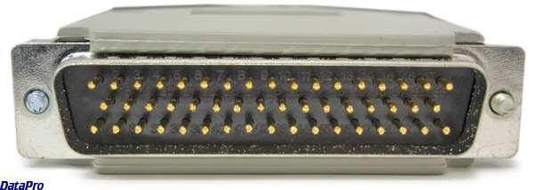
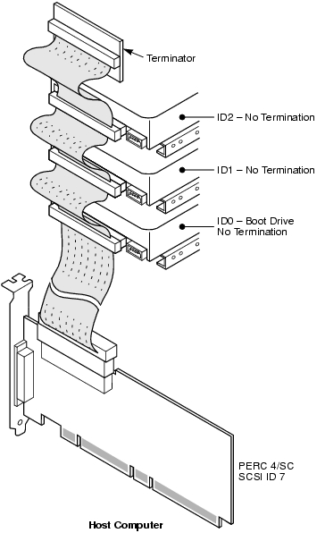
Small Computer System Interface (SCSI)
SCSI types
SCSI Connector
SCSI Terminator

Slide 16
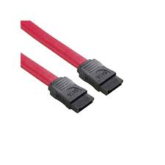
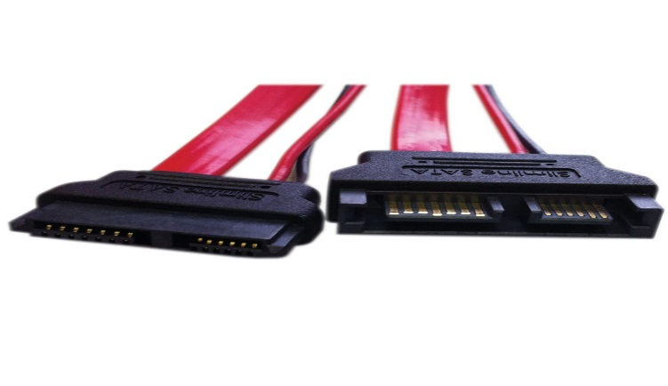
SATA
The SATA ("Serial Advanced Technology Attachment) cable comes with every computer that has been released as of June 2010. These cables are known for transferring data at high rates (from 1.5 to 6 gigabytes per second) .
The cable comes with a few specific purposes that are used by every computer for some form of data access.
The SATA cable is used so that a motherboard can communicate with an internal hard drive, but there are other devices that can make use of the SATA cable as well.

Slide 17
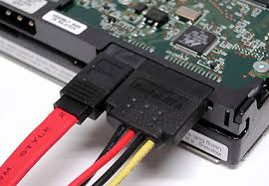
SATA
Serial ATA is a better, more efficient interface than the dated PATA standard.
SATA Connector

